Slide 1
Traffic Rules Violation Detection
Thesis Group
Abdullah Al Nahian Kanon
Roll: 1707030
Md. Saidul Islam Akib
Roll: 1707119
Supervised By
Dr. Muhammad Aminul Haque Akhand
Professor
Department of Computer Science and Engineering
Khulna University of Engineering & Technology
Khulna, Bangladesh

Slide 2
Outline
Introduction
Related Work
Our Contribution
Methodology
Experimental Result
Limitation
References

Slide 3
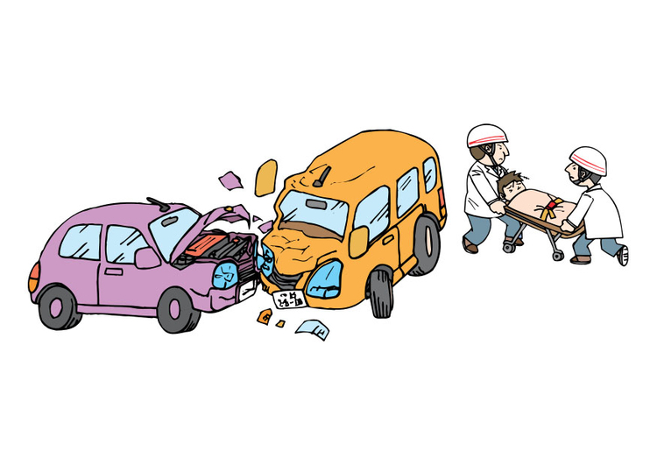

Slide 4
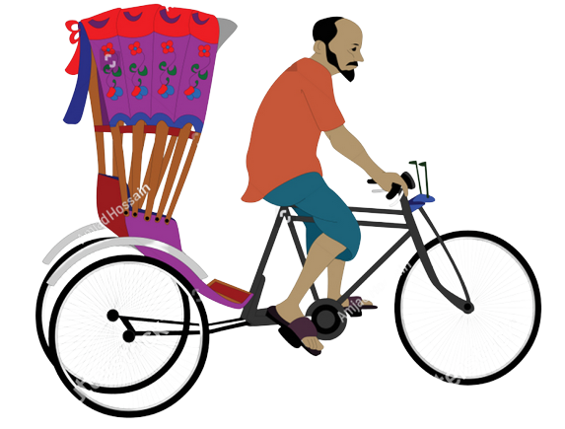

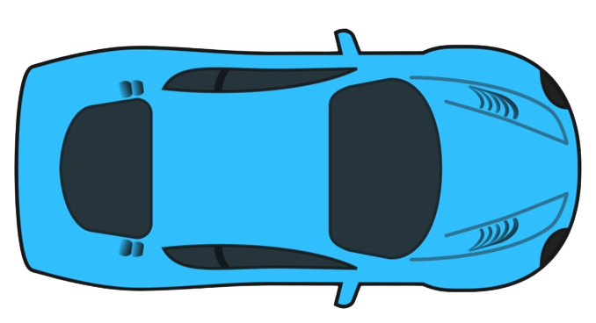
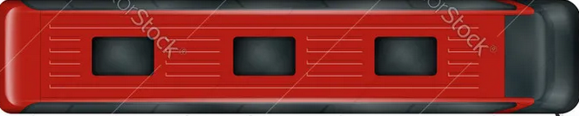
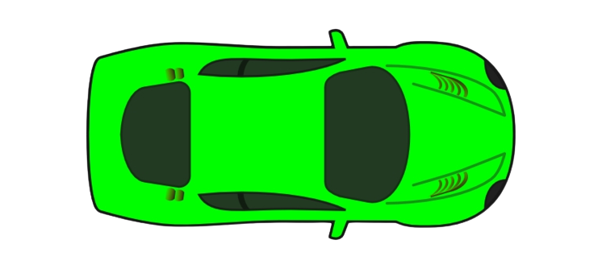
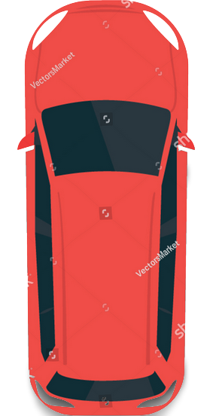
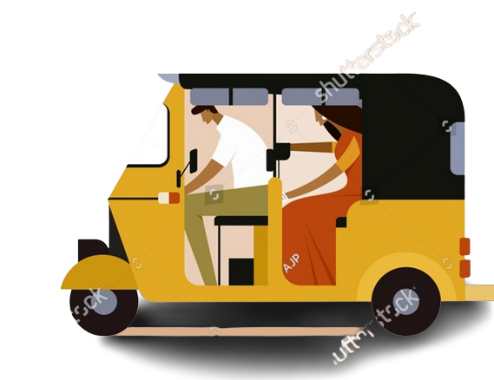
Introduction
Introduction
Related Work
Our Contribution
Methodology
Experimental Result
Limitation
References
license plate number
traffic police station
traffic rules violation detection system
or image of vehicle

Slide 5
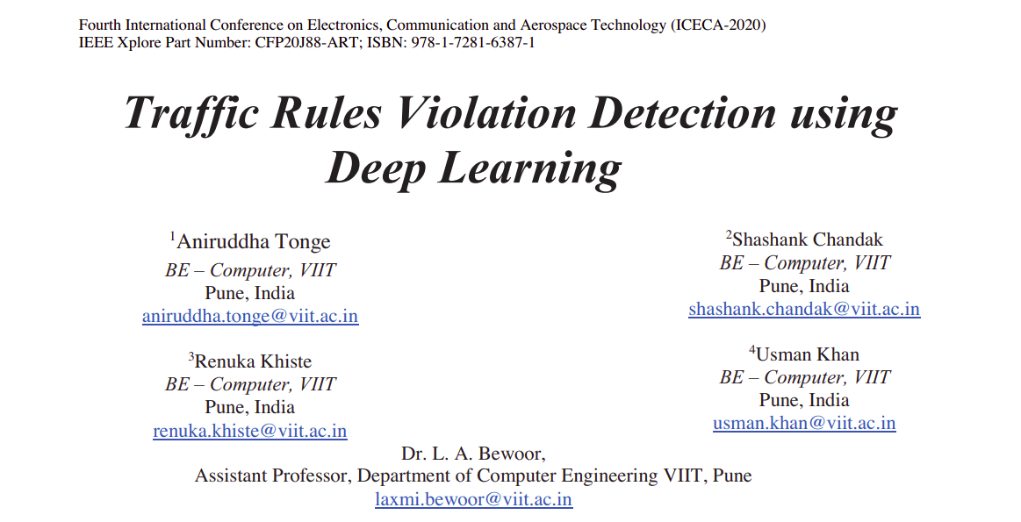
Related Works
Introduction
Related Work
Our Contribution
Methodology
Experimental Result
Limitation
References

Slide 6
Related Works
Introduction
Related Work
Our Contribution
Methodology
Experimental Result
Limitation
References
Tonge et al. in [1] used a deep learning technique to detect vehicle, helmet classification, crosswalk violation in traffic signal and Licence plate detection.
Limitations:
Not wide variety of traffic rules violation detection
Not good when there are heavy traffic
Dataset used does not properly reflect bangaldesh’s highway road vehicles or other vehicles

Slide 7
Our Contribution
Introduction
Related Work
Our Contribution
Methodology
Experimental Result
Limitation
References
Implementing more trafiic rules violation detection techniques
Creating a large dataset of Bangladesh Highway Vehicles

Slide 8
Methodology
Introduction
Related Work
Our Contribution
Methodology
Experimental Result
Limitation
References
Dataset
Trained Model
Input Video
Stream
Transformingvideo into
Frames
Violation Detection
Mecahnism
Vehicle Images
License Plate Number
Traffic Rules

Slide 9
Methodology
Introduction
Related Work
Our Contribution
Methodology
Experimental Result
Limitation
References
Violation of Traffic Rules
Vehicles in wrong lanes
Overspeed Vehicles
Passerby crossing road at green light
Not permitted vehicles in highway
Crosswalk Violation
Motobike drivers without helmet
Other drivers without seat-belt
Vehicle of Unusual behavior

Slide 10
Methodology
Introduction
Related Work
Our Contribution
Methodology
Experimental Result
Limitation
References
Model Training
Model trained using YOLOv5 object detection architecture

Slide 11
Methodology
Introduction
Related Work
Our Contribution
Methodology
Experimental Result
Limitation
References
Dataset
Poribohon-BD dataset
Total 9058 images with annotation files of 15 classes total
We used images of 10 classes of vehicles of road
Total 7708 images
Splitted in 70%(training set), 20%(validation set), 10%(test set)

Slide 12
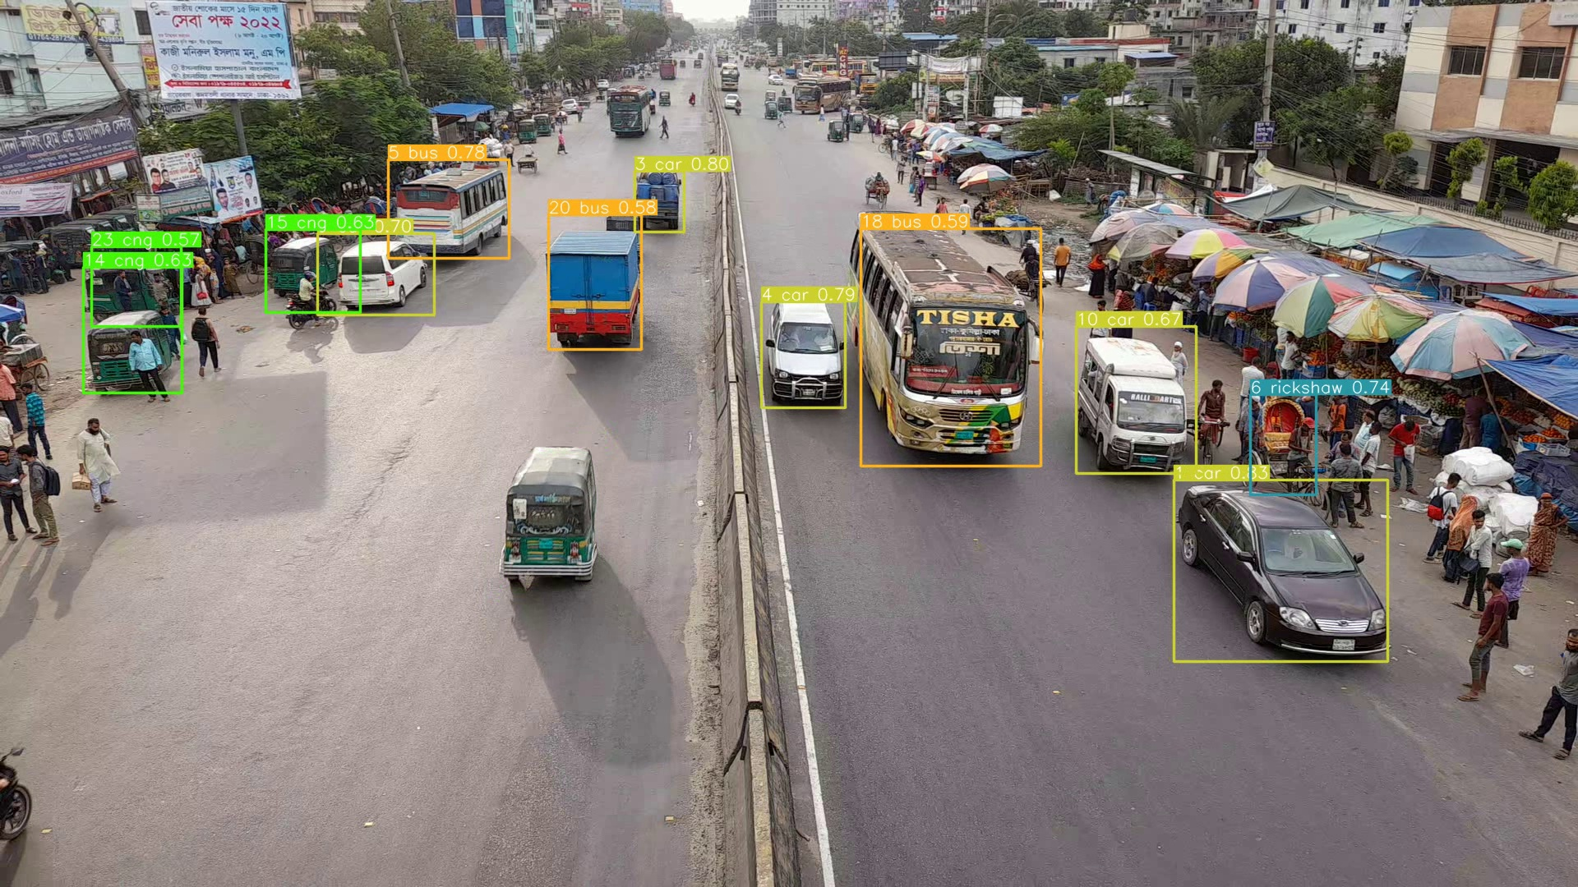
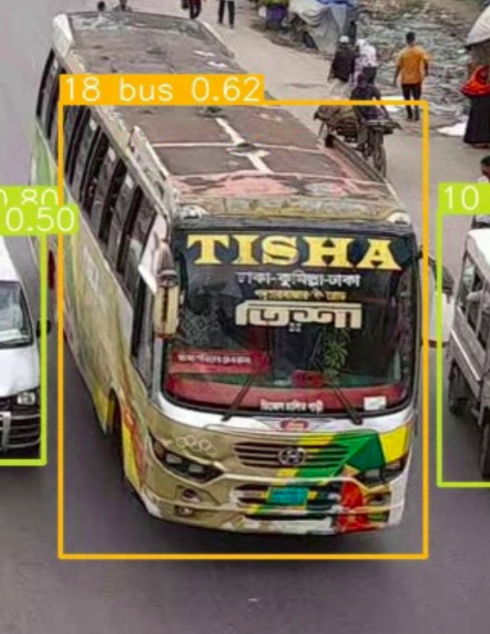

Methodology
Introduction
Related Work
Our Contribution
Methodology
Experimental Result
Limitation
References
Classified vehilce images with unique id

Slide 13
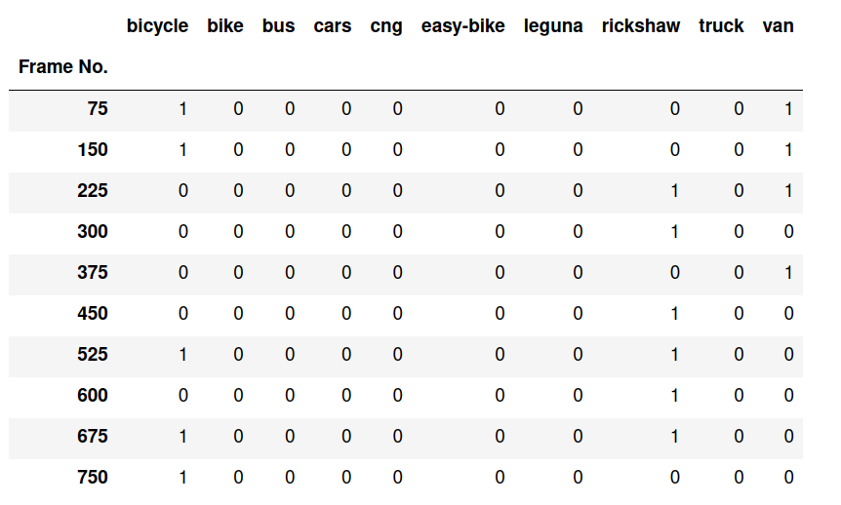
Experimental Result
Introduction
Related Work
Our Contribution
Methodology
Experimental Result
Limitation
References

Slide 14
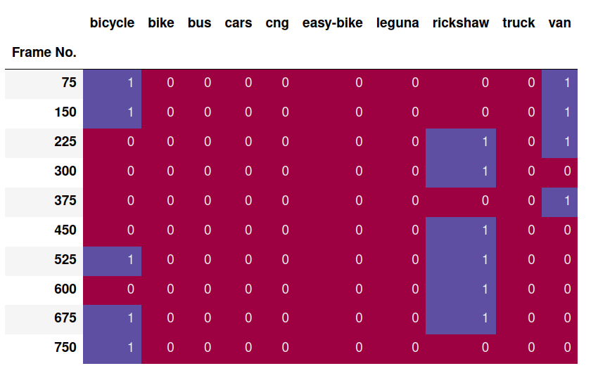
Experimentai Result
Introduction
Related Work
Our Contribution
Methodology
Experimental Result
Limitation
References

Slide 15
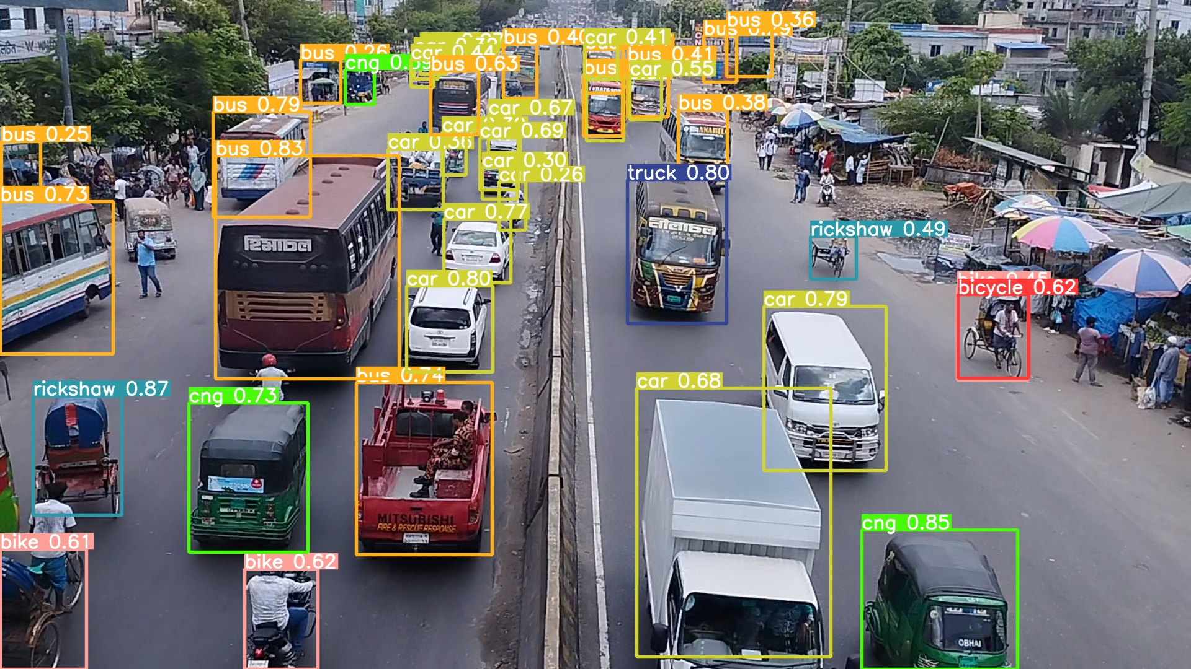
Limitaions
Introduction
Related Work
Our Contribution
Methodology
Experimental Result
Limitation
References
misclassified vehicles

Slide 16
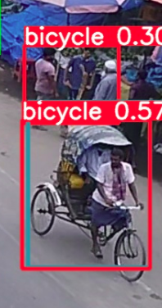
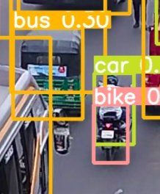
Limitations
Introduction
Related Work
Our Contribution
Methodology
Experimental Result
Limitation
References

Slide 17
Future Goal
Solving the current limitations by creating a large bangladesh’s highway vehicle dataset
Implementing techniques for detecting other types of traffic rules violation
Finally creating a model to detect almost all traffic rules violations and ensure a safe road by punishing the rules violators

Slide 18
References
Aniruddha Tonge, Shashank Chandak, Renuka Khiste, Usman Khan “Traffic Rules Violation Detection using Deep Learning”. DOI: 10.1109/ICECA49313.2020.9297495

Slide 19
Thank You

